Slide 1


SMART FISH PONDS ENABLED WITH CLOUD APPLICATIONS
BATCH -10
TEAM NAME:ROLLY VORTEX
P.SATYA KRISHNA-CSE-1B
A.SHIVASREE-ECE-2A
K.SAHITHI-ECE-2C
K.ANUSHA

Slide 2
Abstract:
Fish keeping is a popular trend nowadays. People from all the age groups like to keep fish at their homes, offices etc. for decoration purpose or as a hobby. Commercial fish farming and ornamental fish farming has become very popular. Therefore it’s important to automate aquariums/ponds as it is difficult to check the conditions of an aquarium manually. During periodic intervals, water needs to be changed, the fish needs to be fed, the temperature, pH level and water level of the aquarium needs to be maintained.

Slide 3
A fish pond is only appropriate when there is a sufficient amount of land , a source of fresh water and a suitable climate.
Water quality is an important parameter which dominates the quality of life of marine animals. Thus monitoring the quality of water is very important. Some of the important parameters of water to be monitored are water temperature and water quality
Fishes are cold blooded creatures and any variation in temperature of water hamper the growth of fishes.
Through This project we can monitor the water quality and water temperature by using some sensors. we can alert the concerned person if the water quality is poor and if the water temperature is in-appropriate so that he may take necessary precautions. the fishes has to be feed on time.

Slide 4
If the person is not near the fish pond he may not feed them at the correct time and this may cause them a huge loss. to overcome that we can automate the feeding mechanism by keeping some motors.
Block Diagram:
ARDUINO UNO
NODE MCU
ESP8266
IBM
CLOUD
MOBILE
APP
Ph SENSOR
TEMPERATURE SENSOR
TURBIDITY SENSOR

Slide 5
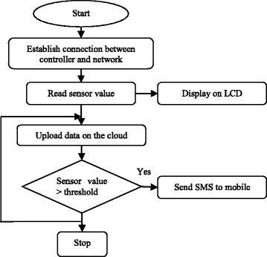
Algorithm:

Slide 6
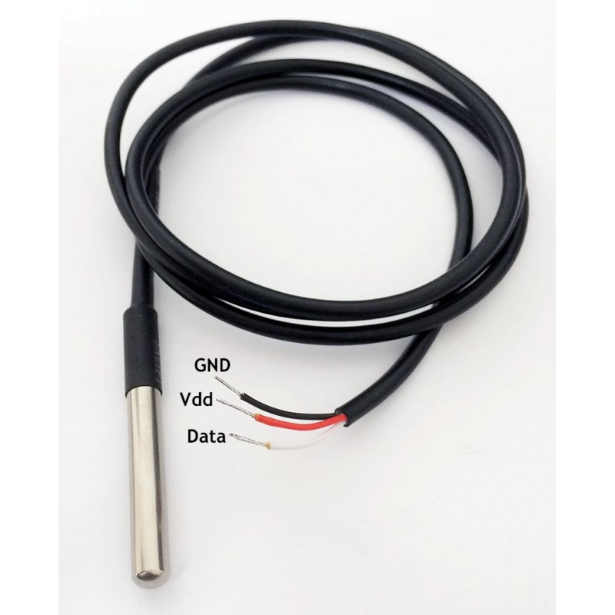
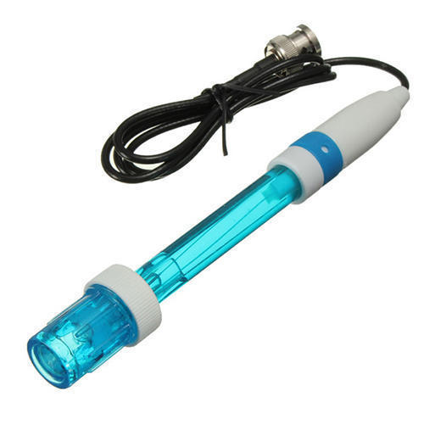
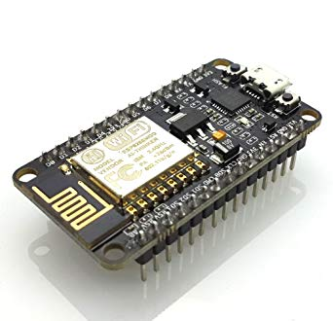
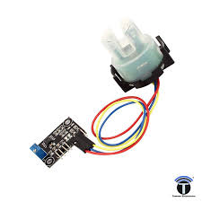
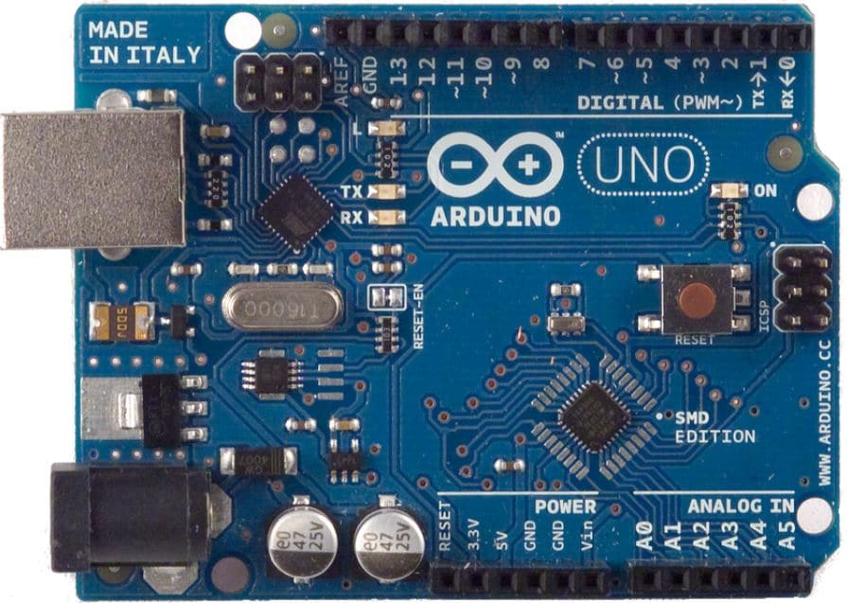
HARDWARE:
Water temperature sensor
pH sensor
Turbidity sensor
Arduino Uno
Nodemcu ESP8266

Slide 7
SOFTWARE:
Arduino IDE
IBM CLOUD
Project Highlights:
GSM/GPRS communication between device and ThingSpeak cloud Platform
Working with the AT commands
ThingSpeak cloud integration between device and mobile App
Sending necessary alerts to the desired person
Controlling the motor through mobile Application

Slide 8
ADVANTAGES
1.To monitor the water quality in real time to ensure safe supply of water.
2. To monitor the water quality by measuring various water quality parameters such as dissolved oxygen, conductivity, and turbidity using various sensor.
3. To perform real time water quality monitoring by using Internet of things.
DISADVANTAGES
1.Requires manual operation to submit data, some configuration required.
2.Costly, usually only feasible under Exchange Network grants
3.Technical expertise and network server required.

Slide 9
CONCLUSION -
We have developed an automated aquarium which controls parameters such as temperature, pH . We have incorporated an automatic feeder .

Slide 10


